Slide 1
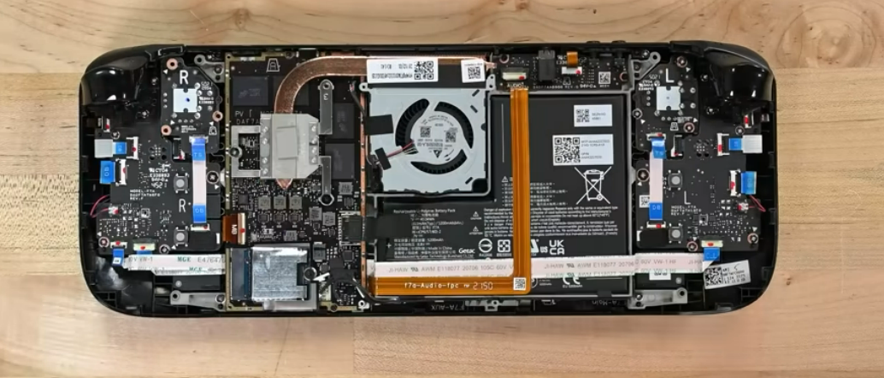
Steam Deck Dissection
It is super impressive that this device is able to run 16Gb of DDR4 RAM
Trigger button (Input)
An output device on here would be the display screen, located on the other side of the device
SSD / Hard Drive
Power Supply

Slide 2
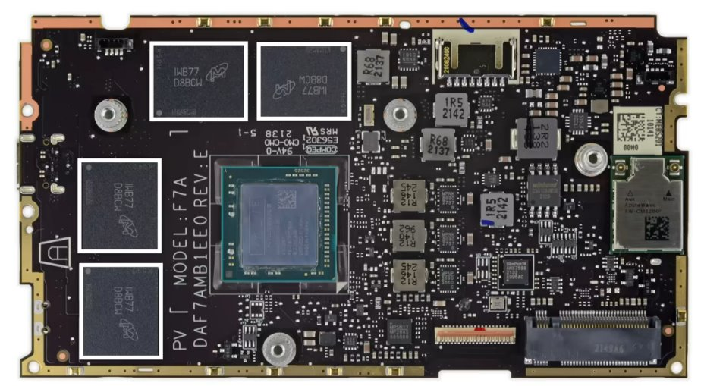
Steam Deck Motherboard
RAM
RAM
Network Adapter
CPU

Slide 3
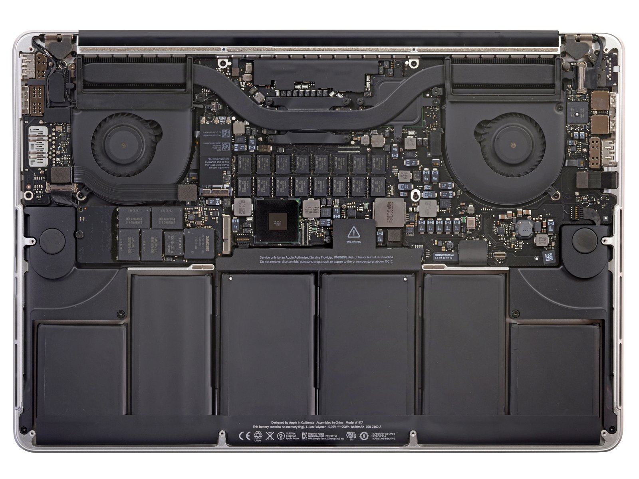
2012 Macbook Pro Dissection
I love how this device has so much memory. It has DDR4 and DDR5 RAM working together.
USB & Thunderbolt Ports (Input)
SSD / Hard Drive
An output device on here would also be the 15 inch display on the other side of the device.
Power Supply

Slide 4
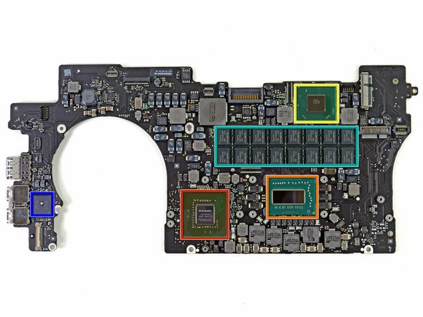
2012 Macbook Pro Logic Board (Motherboard)
Network Adapter
CPU
GPU

Slide 5
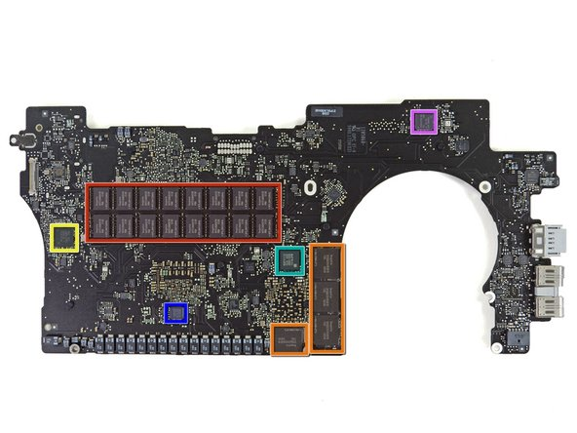
2012 Macbook Pro Logic Board Back (Motherboard)
More Memory
RAM

Slide 6
Reflection
These devices were obviously very different, however, the motherboards had very similar layouts. Both devices had those 4 pieces of DDR4 RAM, although the MacBook also had DDR5. When looking at the motherboard, you can see that the network adapters on both devices are on the opposite side of the motherboard from the rest of the components. It honestly wasn't super hard to find all the components on either device as the motherboard is fairly organized. I picked the steam deck because it’s a unique piece of technology since it has the computing power of a desktop but in a hand-held device. One main thing I noticed is the huge difference in repairability between the two devices. The MacBook is immensely harder to put back together after taken apart. However, the steam deck is easy to put back together, except for the power supply. Overall, I really enjoyed this activity, and I got to understand a lot more about how these devices component's work together.

